Slide 1
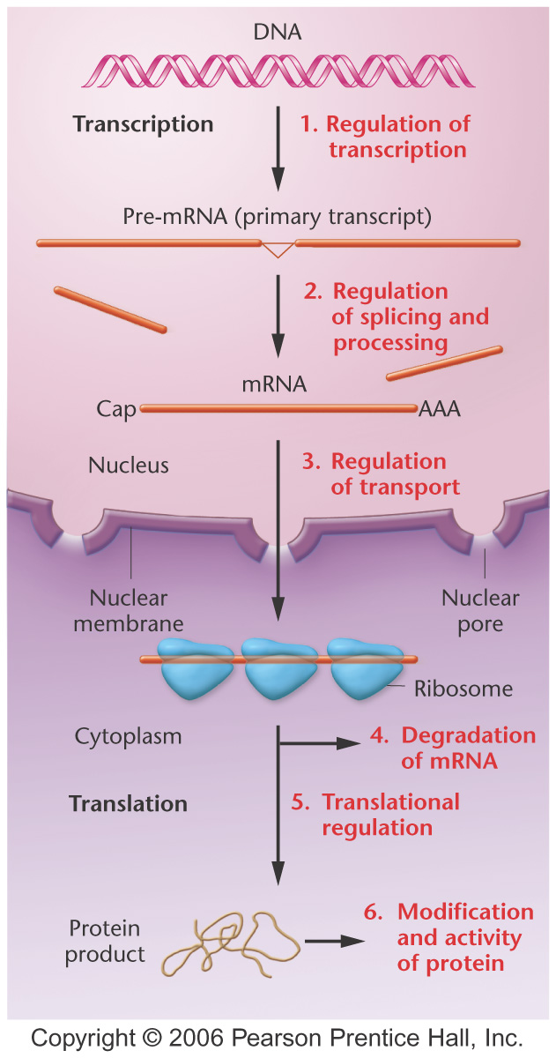
From DNA to Protein

Slide 2
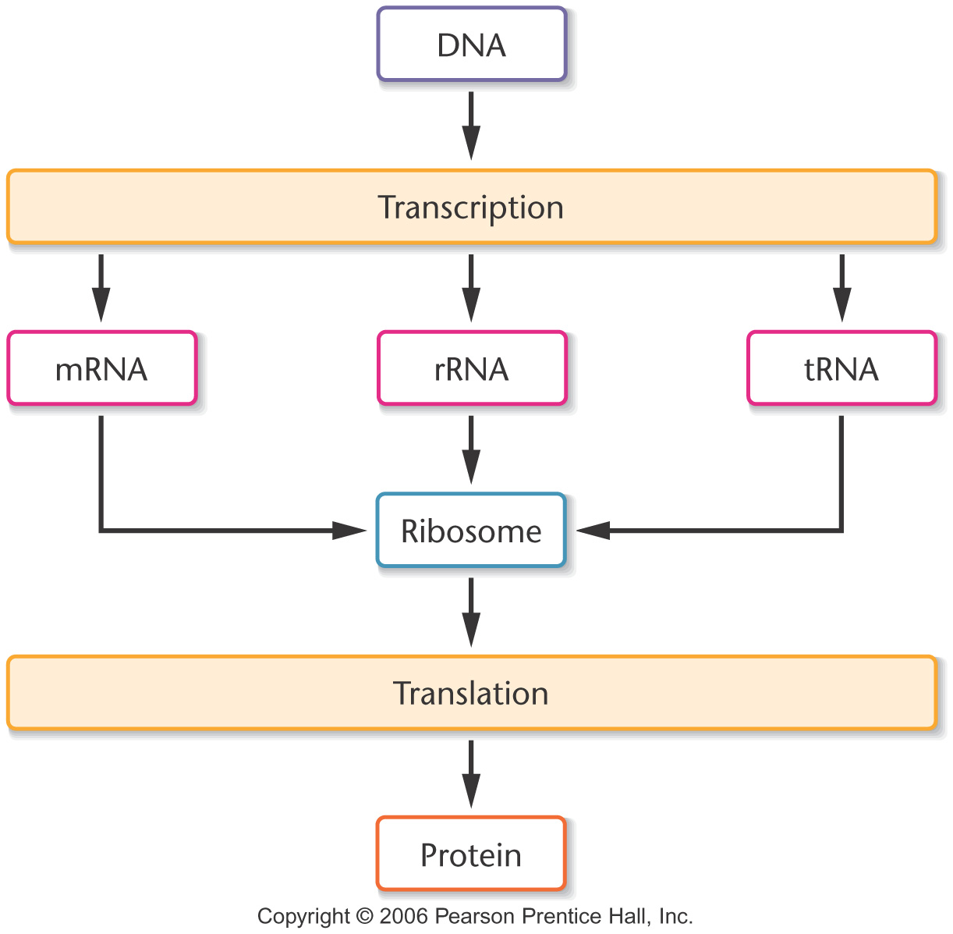
Notes:
Figure 10-1 Simplified view of the central dogma describing information flow involving DNA, RNA, and proteins within cells.

Slide 3
Knowledge of Nucleic Acid Chemistry Is Essential to the Understanding of DNA Structure

Slide 4
Nucleotides are the building blocks of DNA. They consist of a nitrogenous base, a pentose sugar, and a phosphate group.

Slide 5
A nucleoside contains the nitrogenous base and the pentose sugar. A nucleotide is a nucleoside with a phosphate group added

Slide 6
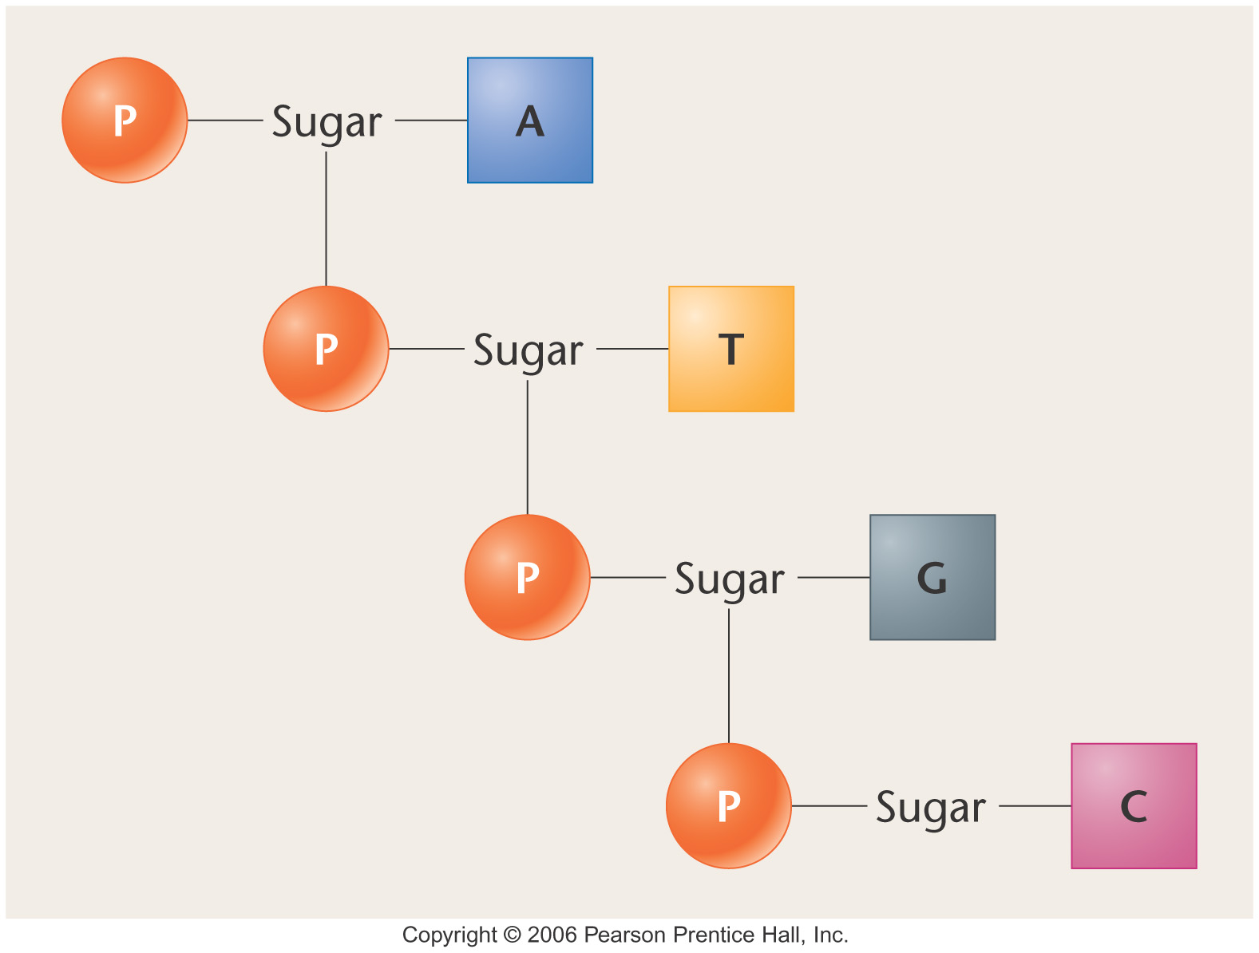
Notes:
Figure 10-2 Diagrammatic depiction of Levene’s proposed tetranucleotide containing one molecule each of the four nitrogenous bases: adenine (A), thymine (T), guanine (G), and cytosine (C). Each block represents a nitrogenous base. Other potential sequences of four nucleotides are possible.

Slide 7
The nitrogenous bases can be purines or pyrimidines. The purines are adenine (A) and guanine (G). The pyrimidines are cytosine (C), thymine (T), and uracil (U)

Slide 8
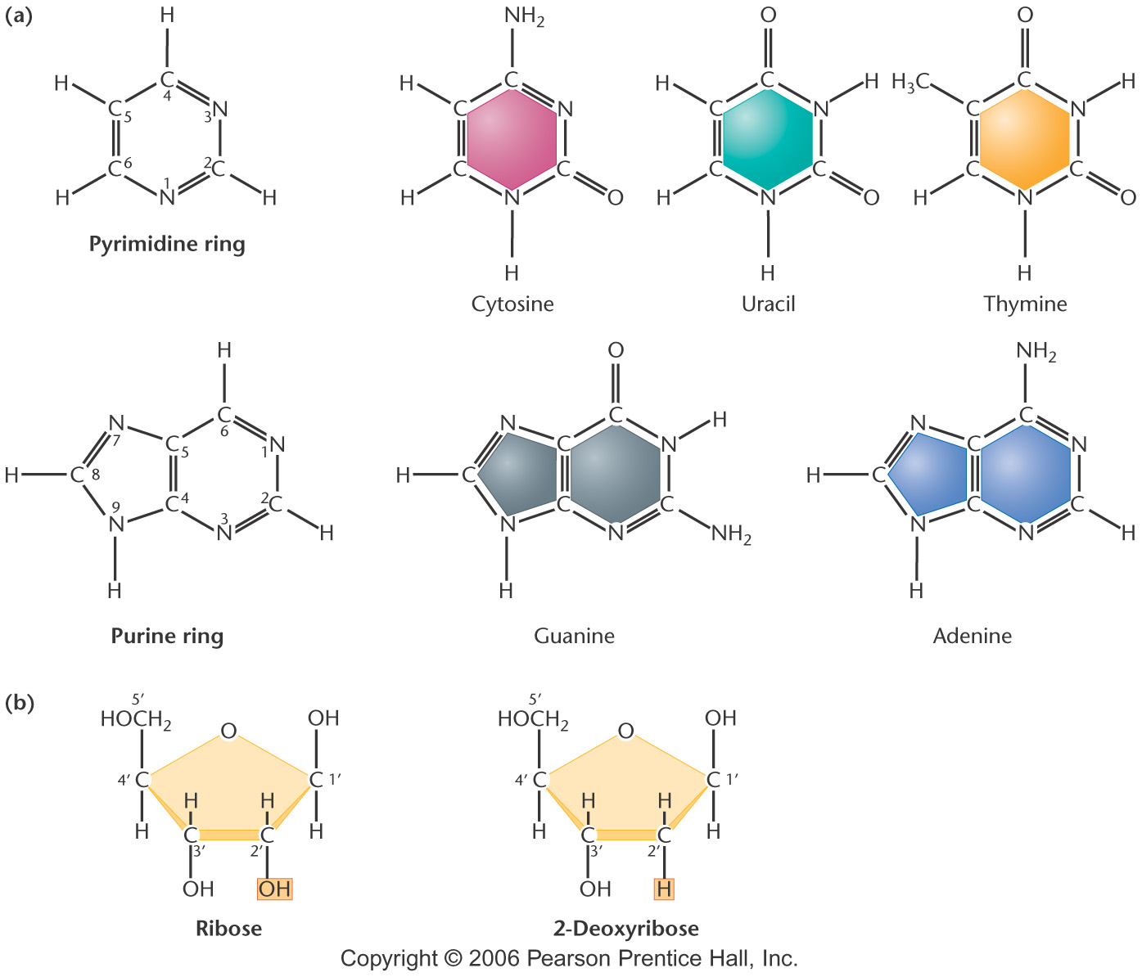
Notes:
Figure 10-9 (a) Chemical structures of the pyrimidines and purines that serve as the nitrogenous bases in RNA and DNA. The nomenclature for numbering carbon and nitrogen atoms making up the two bases is shown within the structures that appear on the left. (b) Chemical ring structures of ribose and 2-deoxyribose, which serve as the pentose sugars in RNA and DNA

Slide 9
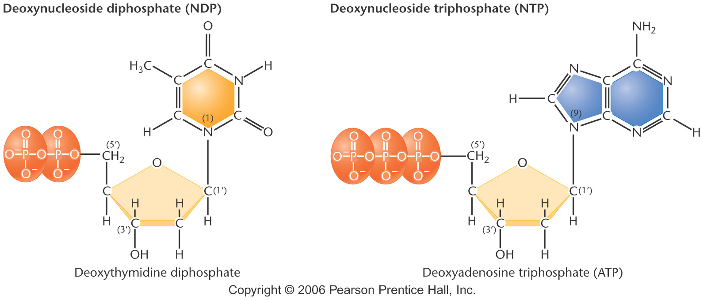
Notes:
Figure 10-11 Basic structures of nucleoside diphosphates and triphosphates, as illustrated by deoxythymidine diphosphate and deoxyadenosine triphosphate

Slide 10
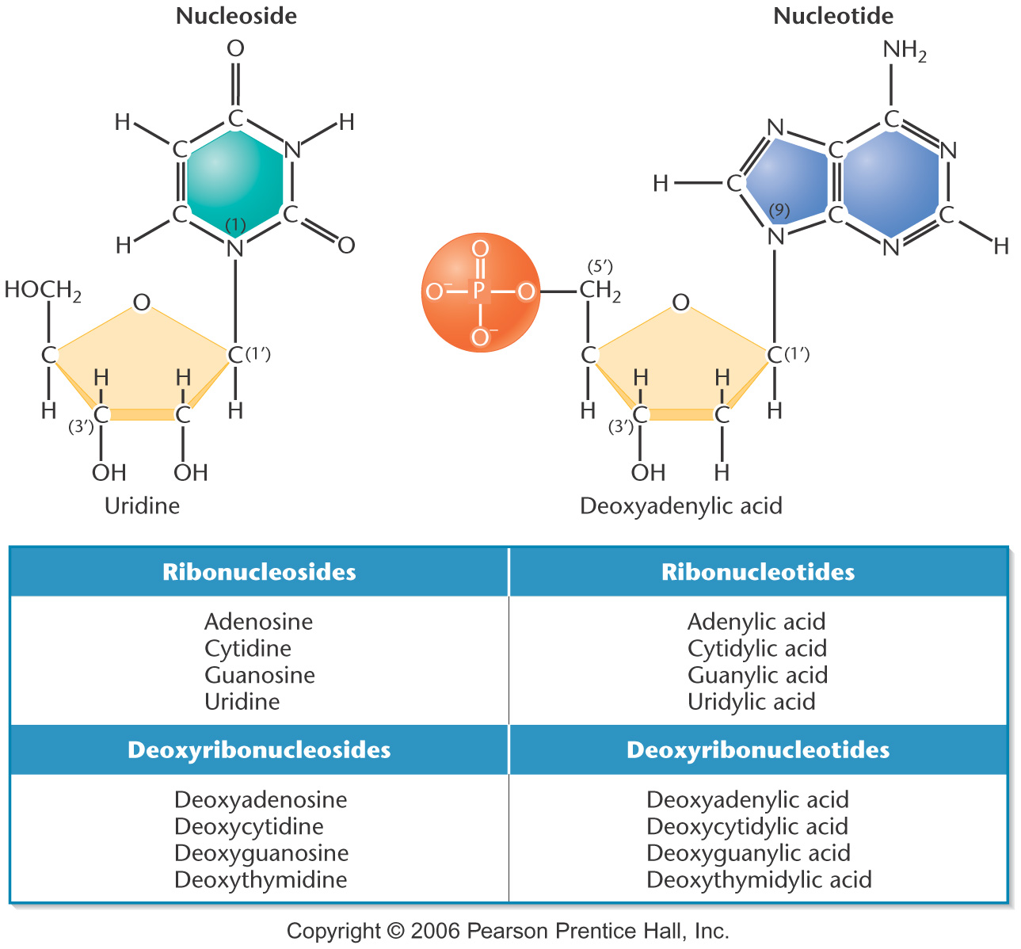
Notes:
Figure 10-10 Structures and names of the nucleosides and nucleotides of RNA and DNA.

Slide 11
DNA and RNA both contain A, C, and G, but only DNA contains T and only RNA contains U.
RNA contains ribose as its sugar; DNA contains deoxyribose
The C-5' position is the location of the
phosphate group on a nucleotide.

Slide 12
Nucleotides are linked by a phosphodiester bond between the phosphate group at the C-5' position and the OH group on the C-3' position

Slide 13
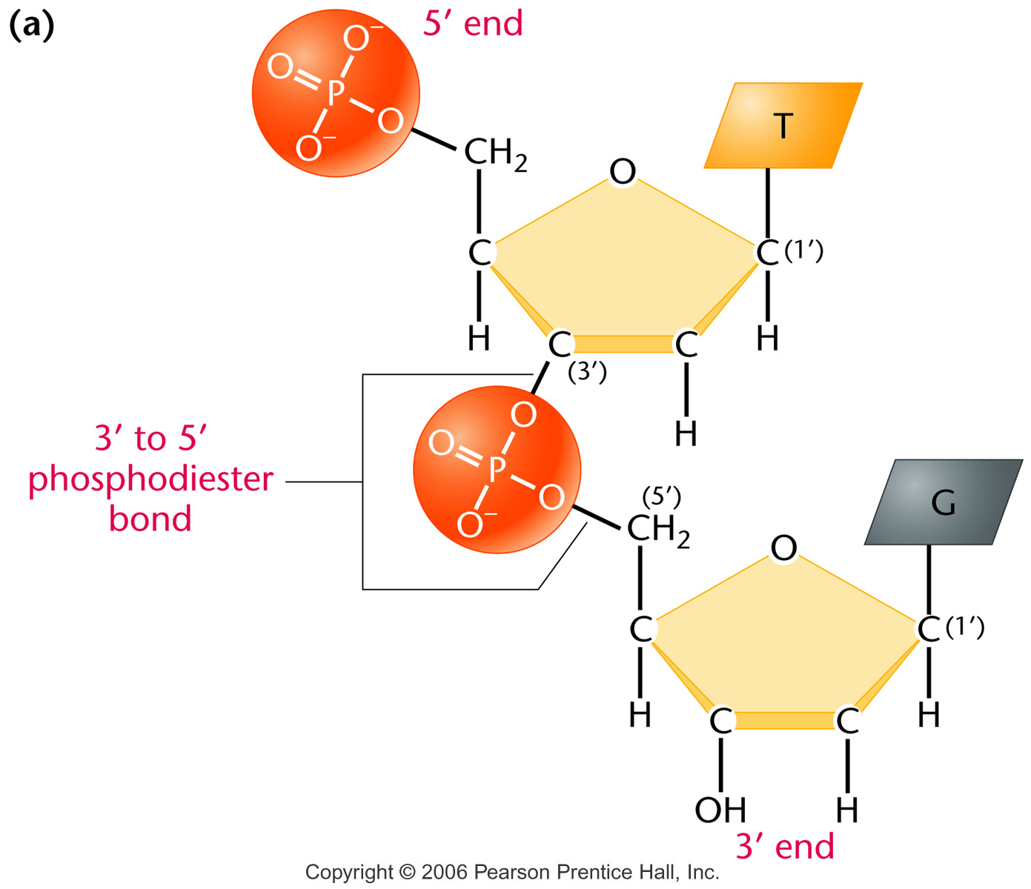
Nucleotides are linked by a phosphodiester bond between
the phosphate group at the C-5' position and the OH
group on the C-3' position
Notes:
Figure 10-12a (a) Linkage of two nucleotides by the formation of a – phosphodiester bond, producing a dinucleotide. (b) Shorthand notation for a polynucleotide chain.

Slide 14
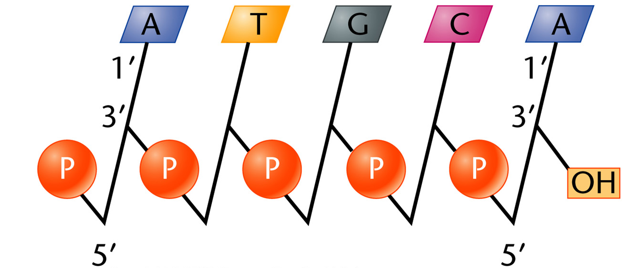
A polynucleotide chain
Notes:
Figure 10-12b (a) Linkage of two nucleotides by the formation of a – phosphodiester bond, producing a dinucleotide. (b) Shorthand notation for a polynucleotide chain.

Slide 15
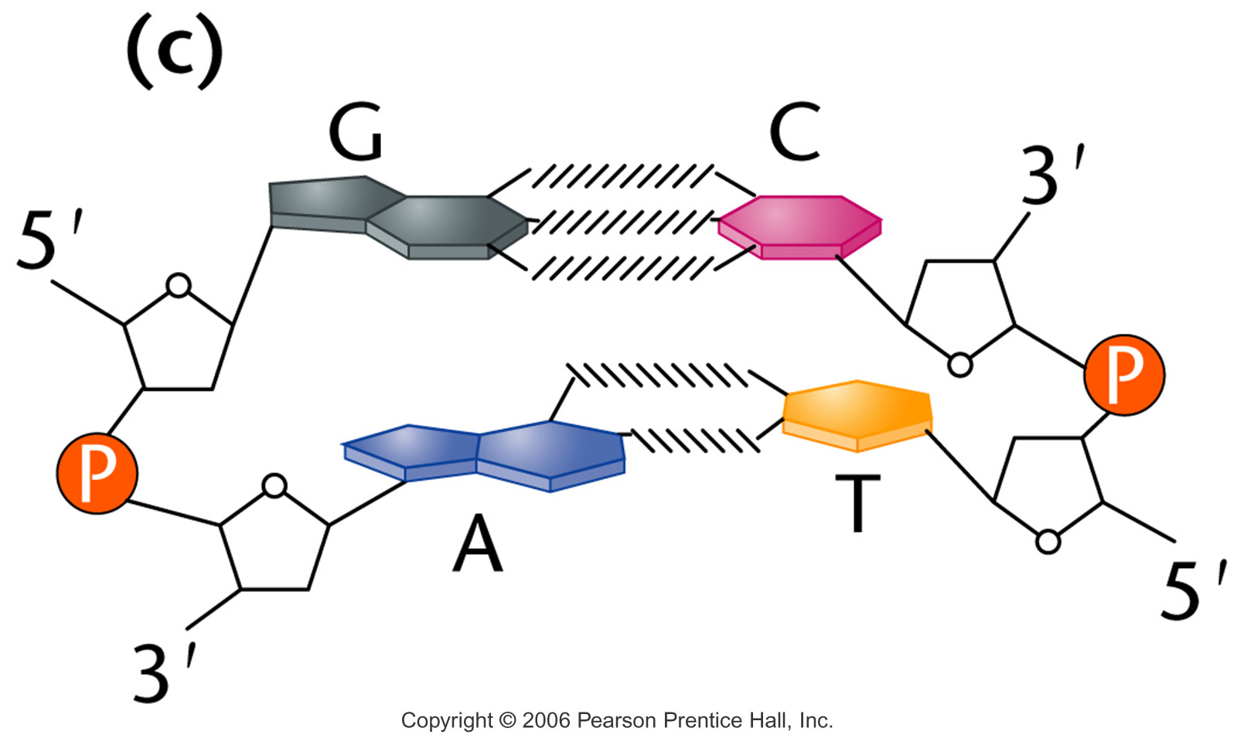
Antiparallel nature of the helix and the horizontal
stacking of the bases.
Notes:
Figure 10_14c (a) The DNA double helix as proposed by Watson and Crick. The ribbonlike strands constitute the sugar-phosphate backbones, and the horizontal rungs constitute the nitrogenous base pairs, of which there are 10 per complete turn. The major and minor grooves are apparent. The solid vertical bar represents the central axis. (b) A detailed view depicting the bases, sugars, phosphates, and hydrogen bonds of the helix. (c) A demonstration of the antiparallel nature of the helix and the horizontal stacking of the bases.

Slide 16
Watson and Crick proposed DNA is a double helix in which the two strands are antiparallel and the bases are stacked on one another. The two strands are connected by A-T and G-C base pairing and there are 10 base pairs per helix turn

Slide 17
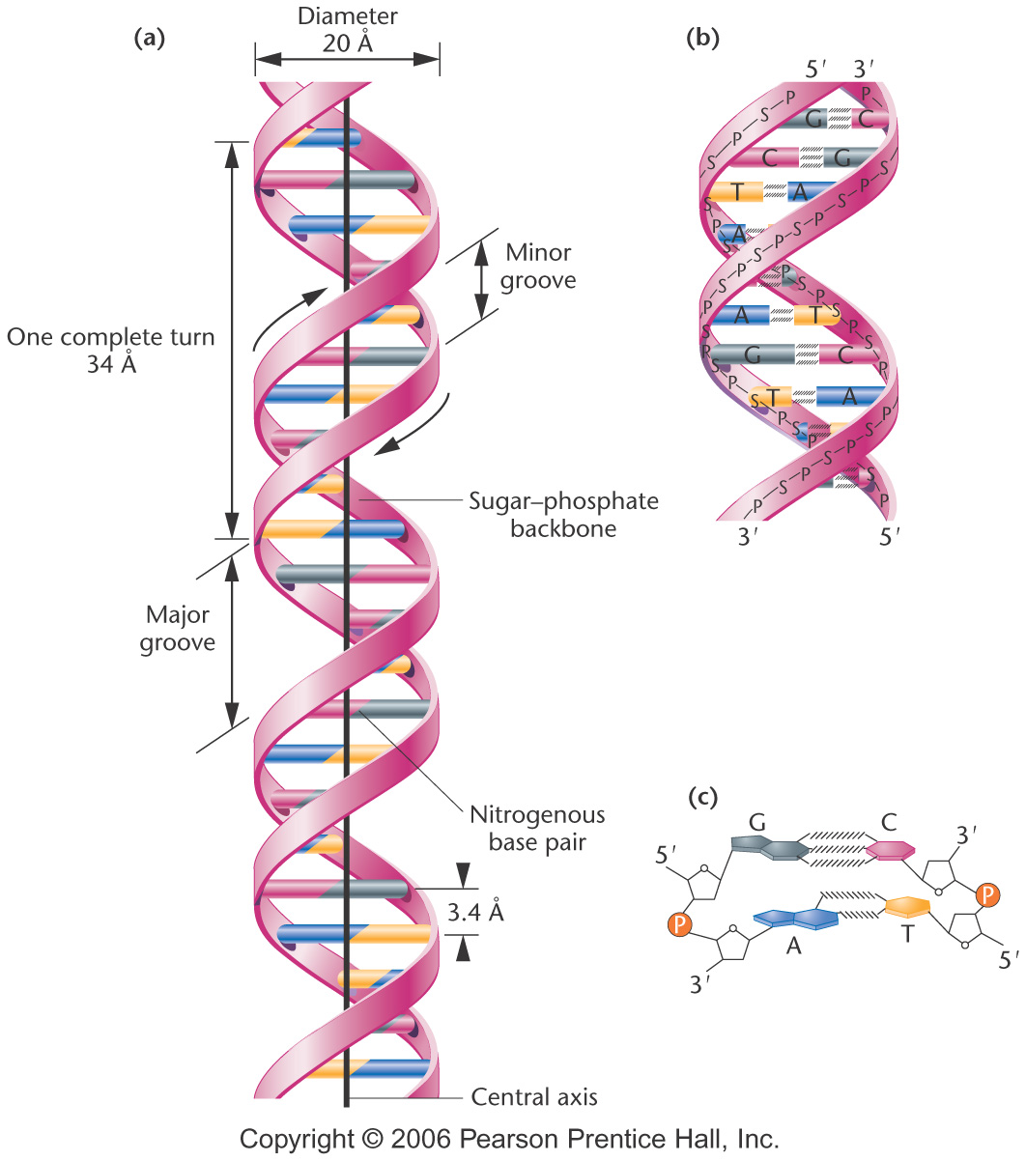
The DNA double helix as proposed by Watson and Crick
Notes:
Figure 10-14 (a) The DNA double helix as proposed by Watson and Crick. The ribbonlike strands constitute the sugar-phosphate backbones, and the horizontal rungs constitute the nitrogenous base pairs, of which there are 10 per complete turn. The major and minor grooves are apparent. The solid vertical bar represents the central axis. (b) A detailed view depicting the bases, sugars, phosphates, and hydrogen bonds of the helix. (c) A demonstration of the antiparallel nature of the helix and the horizontal stacking of the bases.

Slide 18
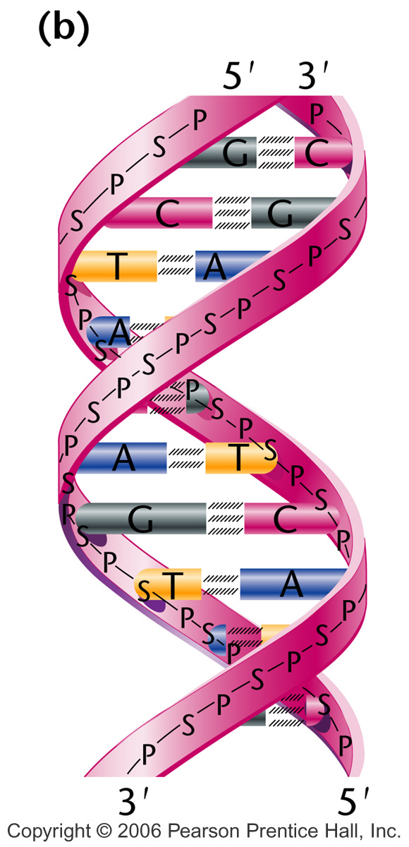
Notes:
Figure 10-14b (a) The DNA double helix as proposed by Watson and Crick. The ribbonlike strands constitute the sugar-phosphate backbones, and the horizontal rungs constitute the nitrogenous base pairs, of which there are 10 per complete turn. The major and minor grooves are apparent. The solid vertical bar represents the central axis. (b) A detailed view depicting the bases, sugars, phosphates, and hydrogen bonds of the helix. (c) A demonstration of the antiparallel nature of the helix and the horizontal stacking of the bases.

Slide 19
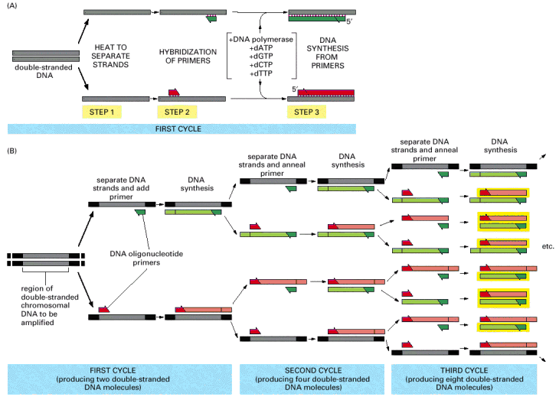
Polymerase Chain Reaction (PCR)

