Slide 1
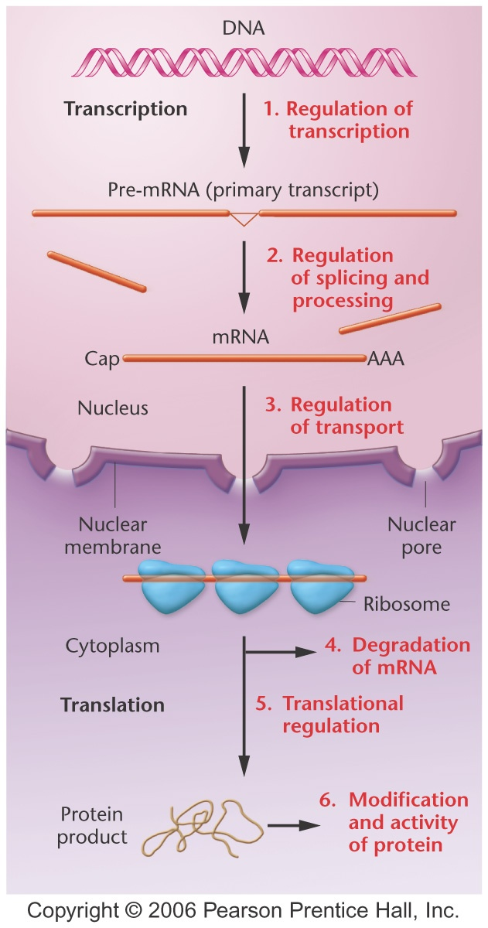
From DNA to Protein

Slide 2
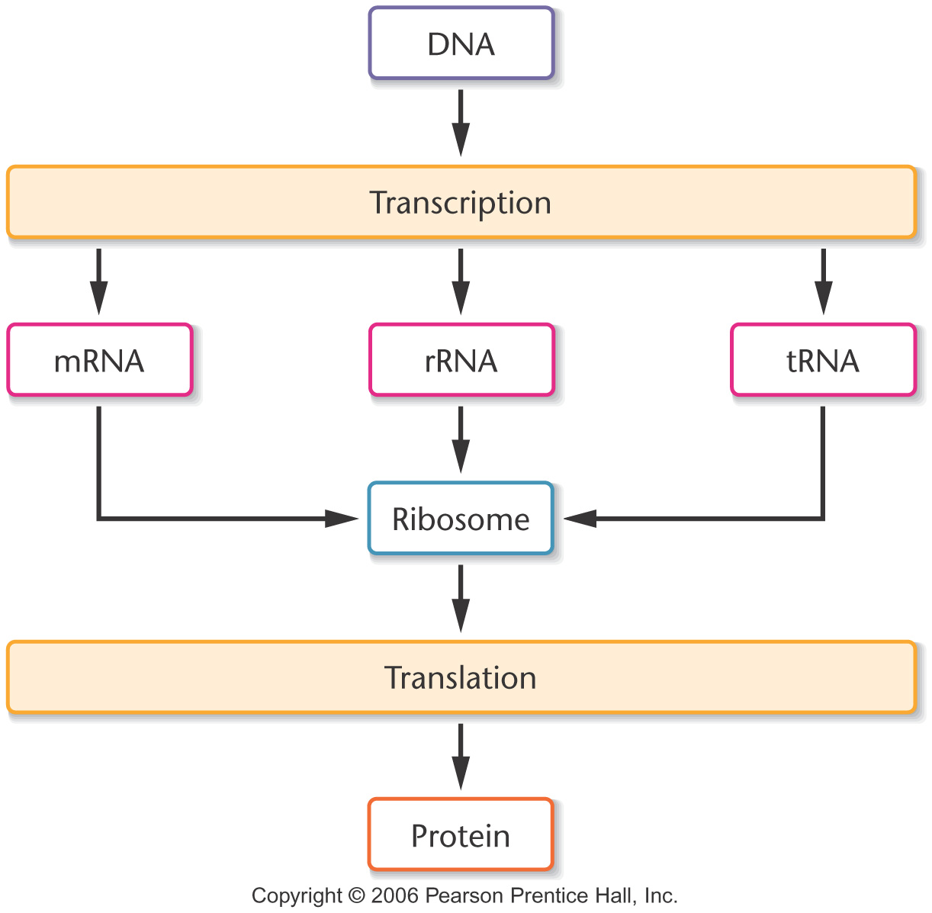
Notes:
Figure 10-1 Simplified view of the central dogma describing information flow involving DNA, RNA, and proteins within cells.

Slide 3
Knowledge of Nucleic Acid Chemistry Is Essential to the Understanding of DNA Structure

Slide 4
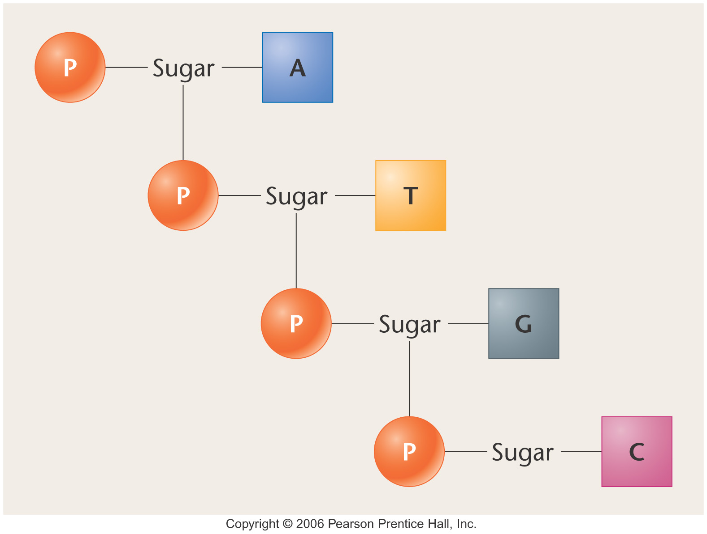
Notes:
Figure 10-2 Diagrammatic depiction of Levene’s proposed tetranucleotide containing one molecule each of the four nitrogenous bases: adenine (A), thymine (T), guanine (G), and cytosine (C). Each block represents a nitrogenous base. Other potential sequences of four nucleotides are possible.

Slide 5
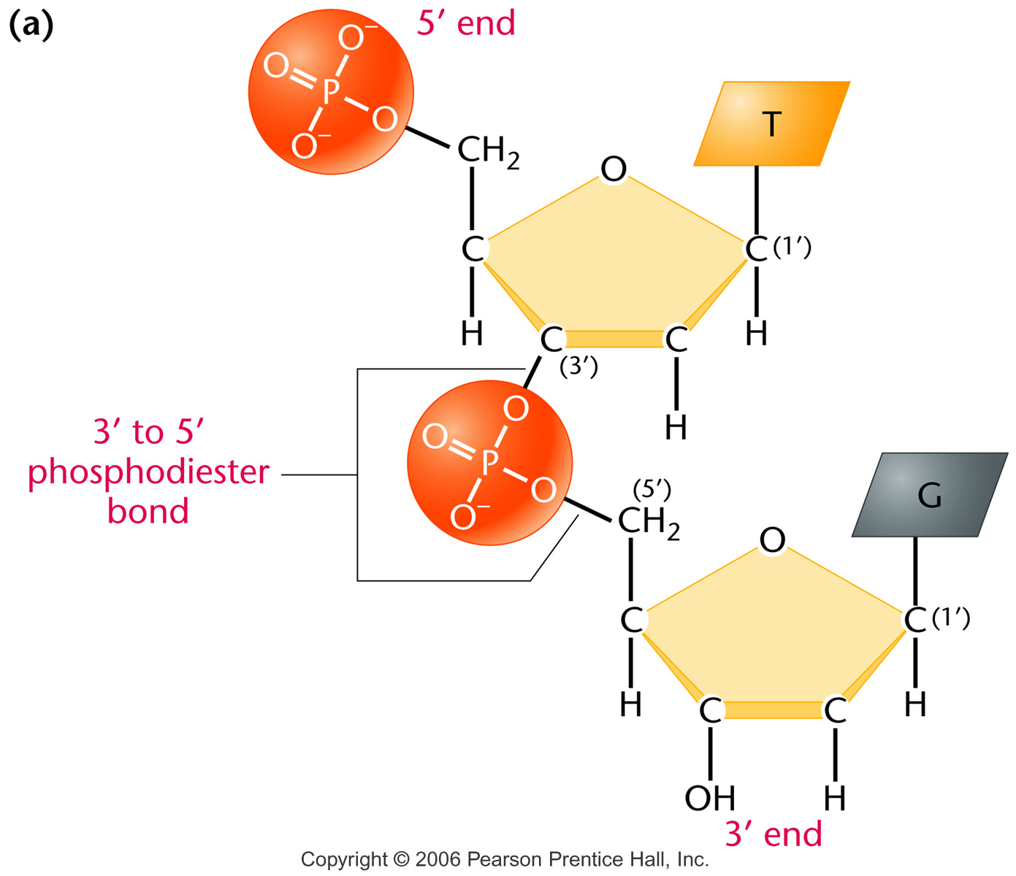
Nucleotides are linked by a phosphodiester bond between
the phosphate group at the C-5' position and the OH
group on the C-3' position
Notes:
Figure 10-12a (a) Linkage of two nucleotides by the formation of a – phosphodiester bond, producing a dinucleotide. (b) Shorthand notation for a polynucleotide chain.

Slide 6
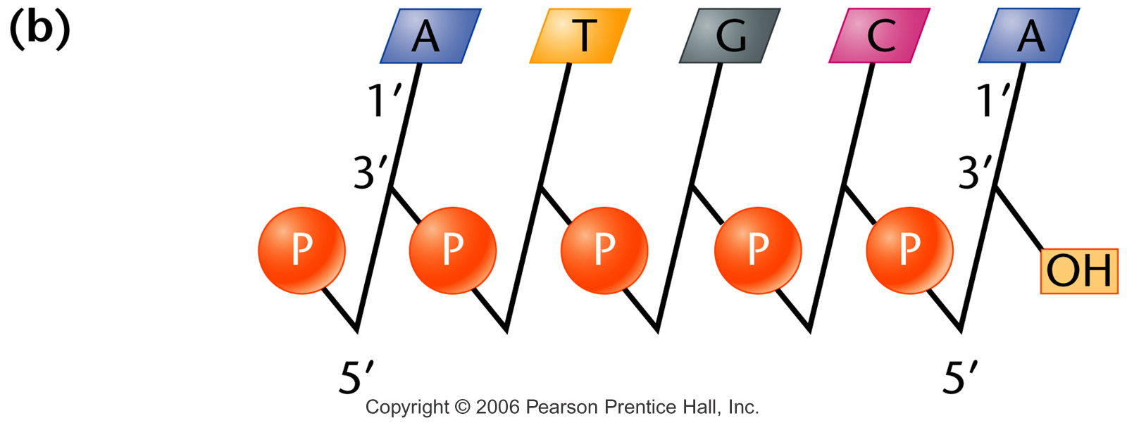
Figure 10-12b Copyright © 2006 Pearson Prentice Hall, Inc.
Notes:
Figure 10-12b (a) Linkage of two nucleotides by the formation of a – phosphodiester bond, producing a dinucleotide. (b) Shorthand notation for a polynucleotide chain.

Slide 7
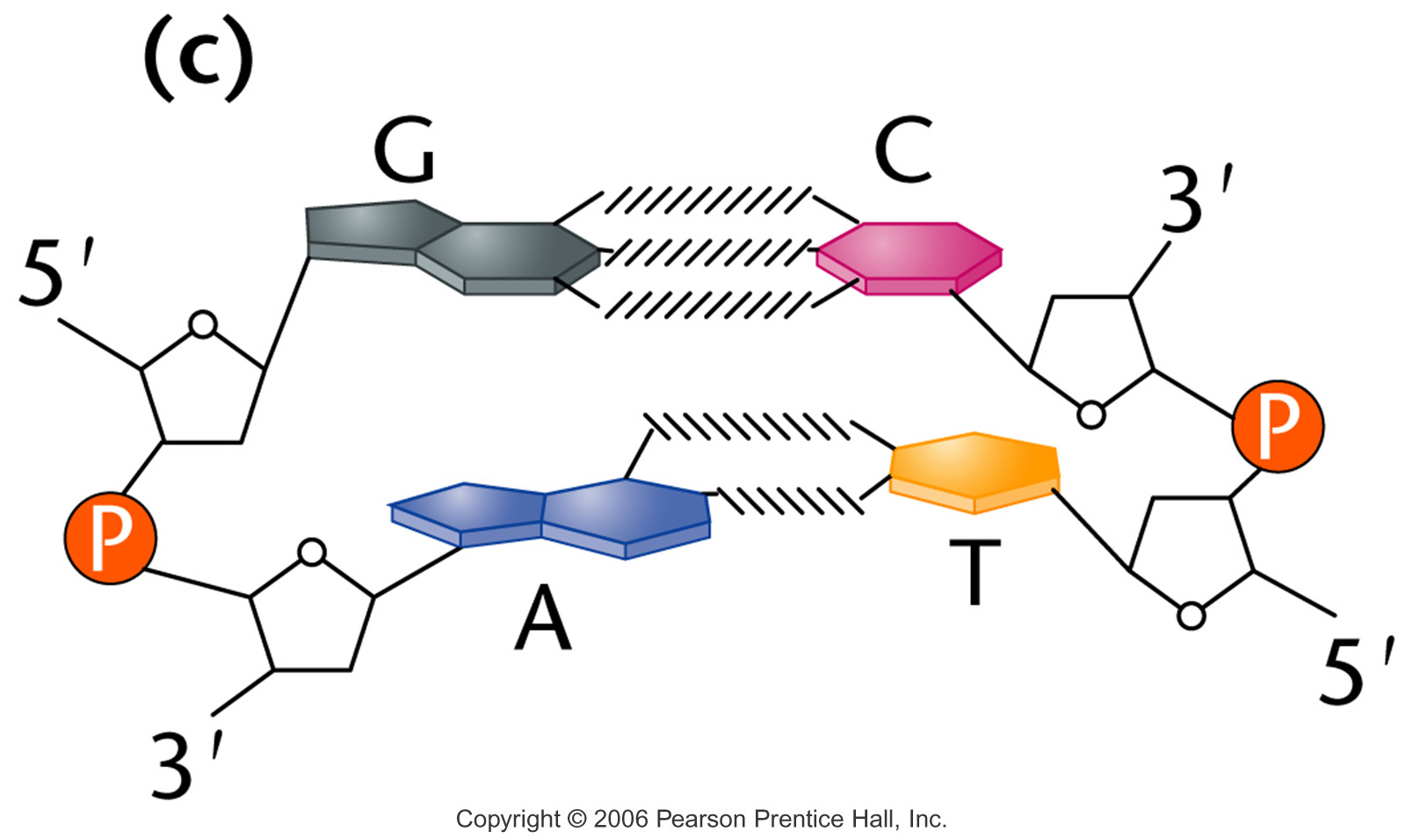
Notes:
Figure 10_14c (a) The DNA double helix as proposed by Watson and Crick. The ribbonlike strands constitute the sugar-phosphate backbones, and the horizontal rungs constitute the nitrogenous base pairs, of which there are 10 per complete turn. The major and minor grooves are apparent. The solid vertical bar represents the central axis. (b) A detailed view depicting the bases, sugars, phosphates, and hydrogen bonds of the helix. (c) A demonstration of the antiparallel nature of the helix and the horizontal stacking of the bases.

Slide 8
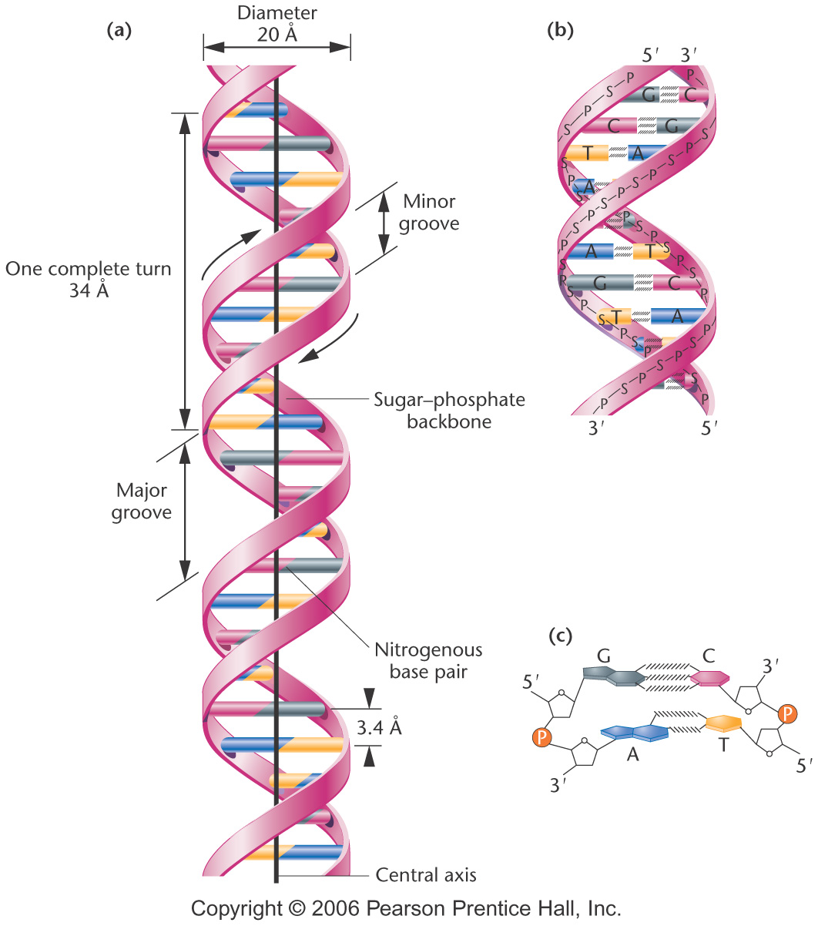
Notes:
Figure 10-14 (a) The DNA double helix as proposed by Watson and Crick. The ribbonlike strands constitute the sugar-phosphate backbones, and the horizontal rungs constitute the nitrogenous base pairs, of which there are 10 per complete turn. The major and minor grooves are apparent. The solid vertical bar represents the central axis. (b) A detailed view depicting the bases, sugars, phosphates, and hydrogen bonds of the helix. (c) A demonstration of the antiparallel nature of the helix and the horizontal stacking of the bases.

Slide 9
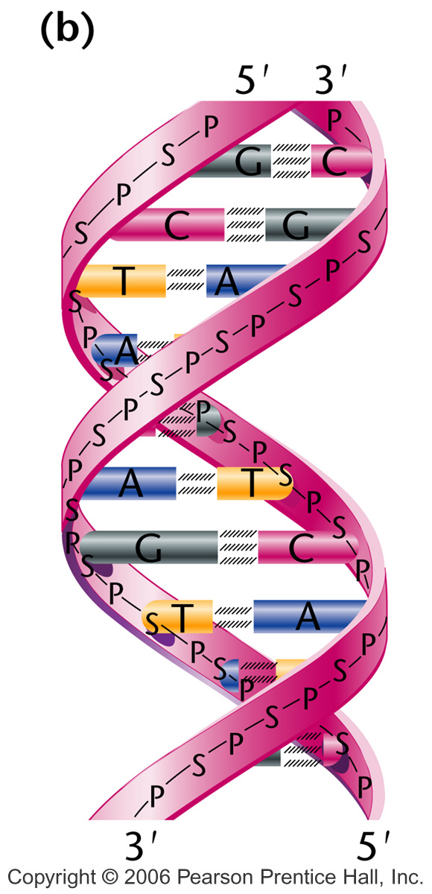
Notes:
Figure 10-14b (a) The DNA double helix as proposed by Watson and Crick. The ribbonlike strands constitute the sugar-phosphate backbones, and the horizontal rungs constitute the nitrogenous base pairs, of which there are 10 per complete turn. The major and minor grooves are apparent. The solid vertical bar represents the central axis. (b) A detailed view depicting the bases, sugars, phosphates, and hydrogen bonds of the helix. (c) A demonstration of the antiparallel nature of the helix and the horizontal stacking of the bases.

Slide 10
DNA and RNA both contain A, C, and G, but only DNA contains T and only RNA contains U.

Slide 11
RNA contains ribose as its sugar; DNA contains deoxyribose

Slide 12
The Genetic Material Must Exhibit Four Characteristics
For a molecule to serve as the genetic material, it must be able to replicate, store information, express information, and allow variation by mutation.

Slide 13
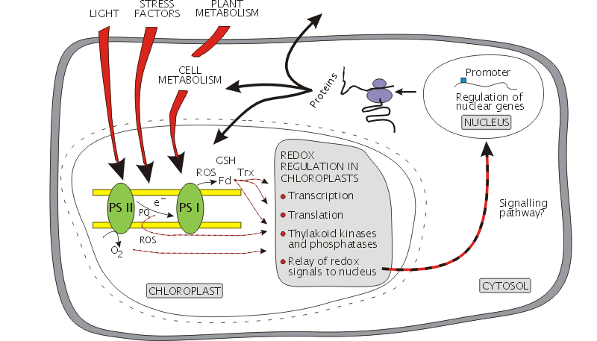
An example of regulation of
cellular functions by Gene expression

Slide 14
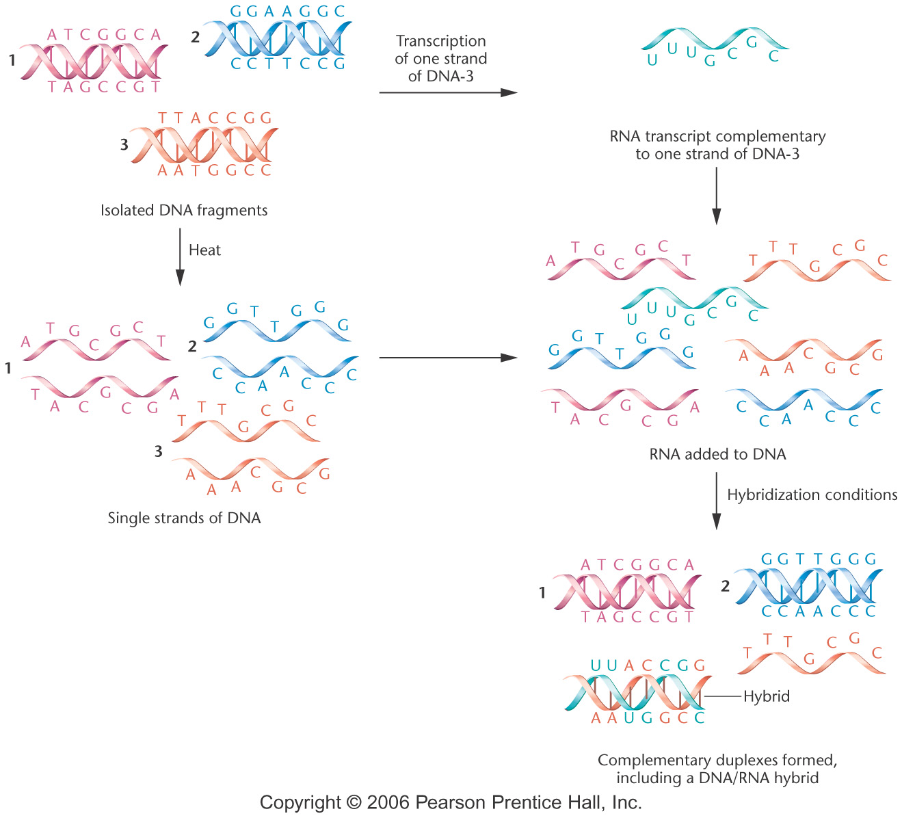
Molecular hybridization between DNA fragments
*
Notes:
Figure 10-21 Diagrammatic representation of the process of molecular hybridization between DNA fragments and RNA that has been transcribed on one of the single-stranded fragments.

Slide 15
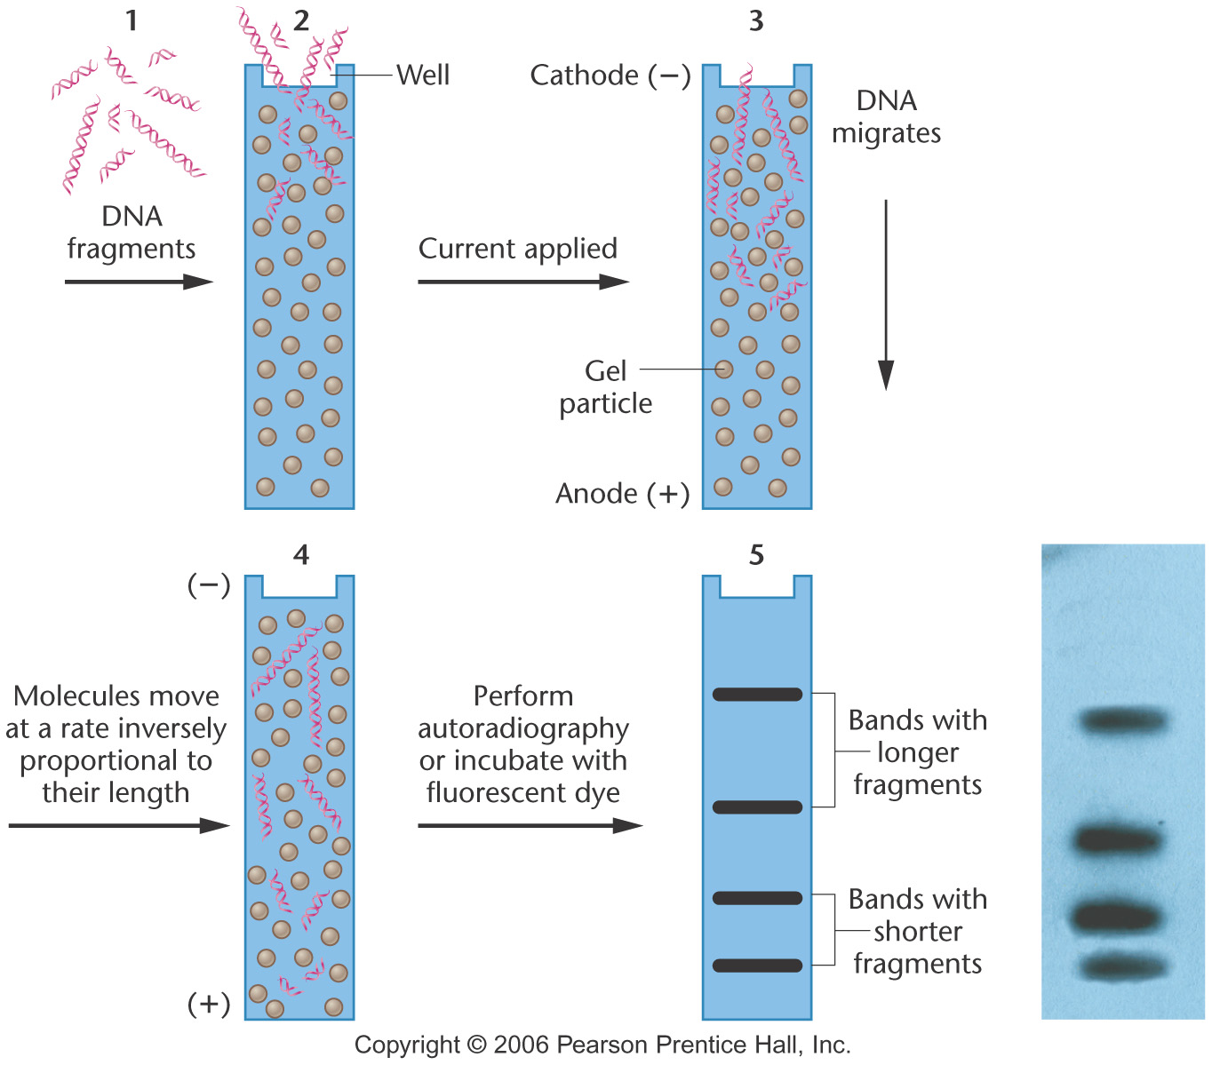
Electrophoretic separation of a mixture of DNA fragments
Notes:
Figure 10-27 Electrophoretic separation of a mixture of DNA fragments that vary in length. The photograph shows an agarose gel with DNA bands corresponding to the diagram.

Slide 16
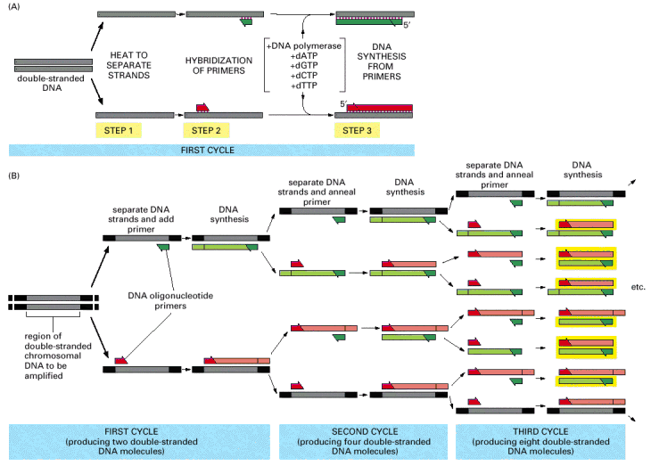
Polymerase Chain Reaction (PCR)

Slide 17
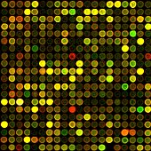
Micro-array technique allow study of all the genes (within a genome)
in a single experiment
Each spot represent a single gene
RNA from two conditions (+/- O2)
are isolated
-RNA (red and green-representing
two conditions) hybridized to slide
Images merged. Ex: green=no O2
Red= plus O2
Green spot: only expressed in no O2
Red spot: expressed only in plus O2
Yellow: Expressed in both condition
http://www.bio.davidson.edu/courses/genomics/chip/chip.html

Slide 18
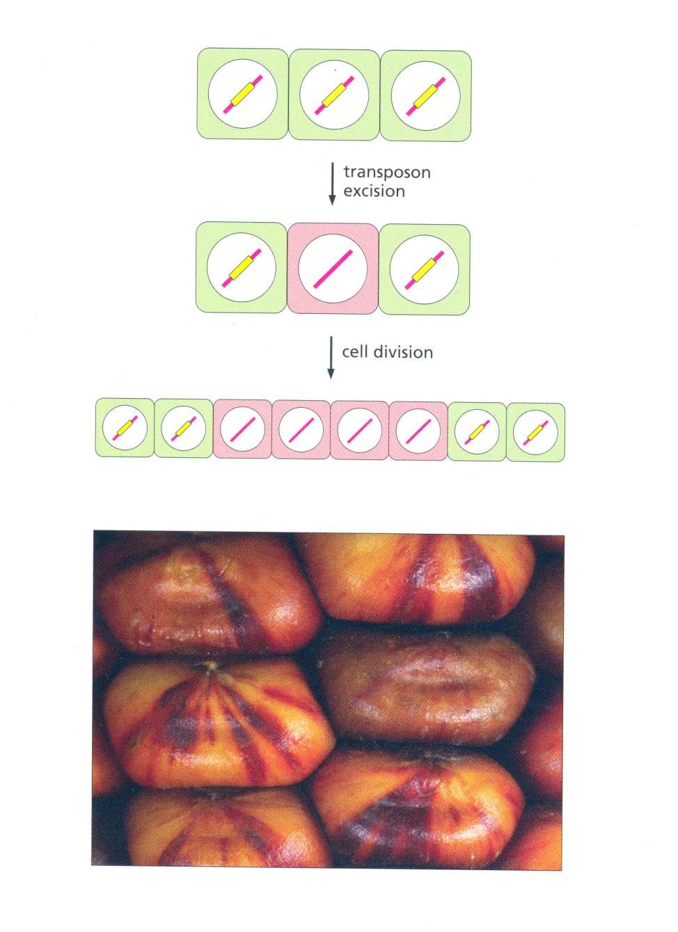
Transposons in Plants: Jumping Genes

Slide 19
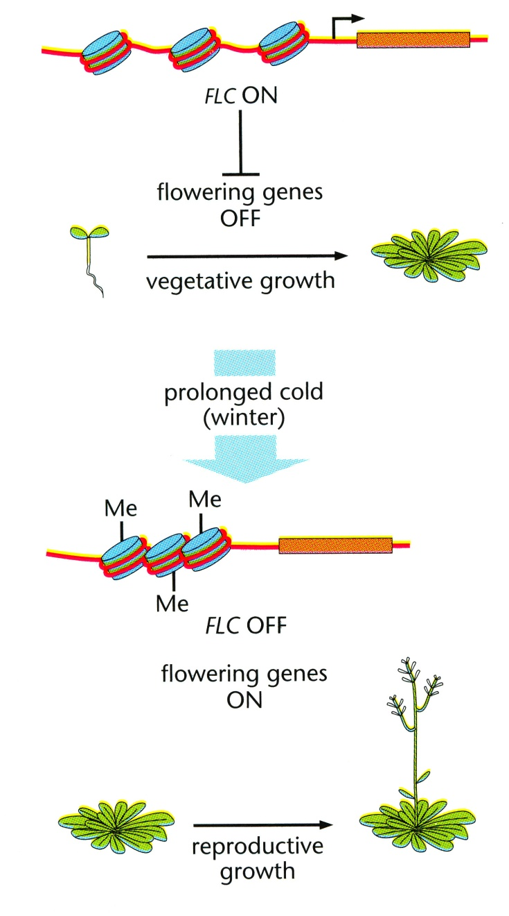
Control of Flowering by Histone Modification

Slide 20
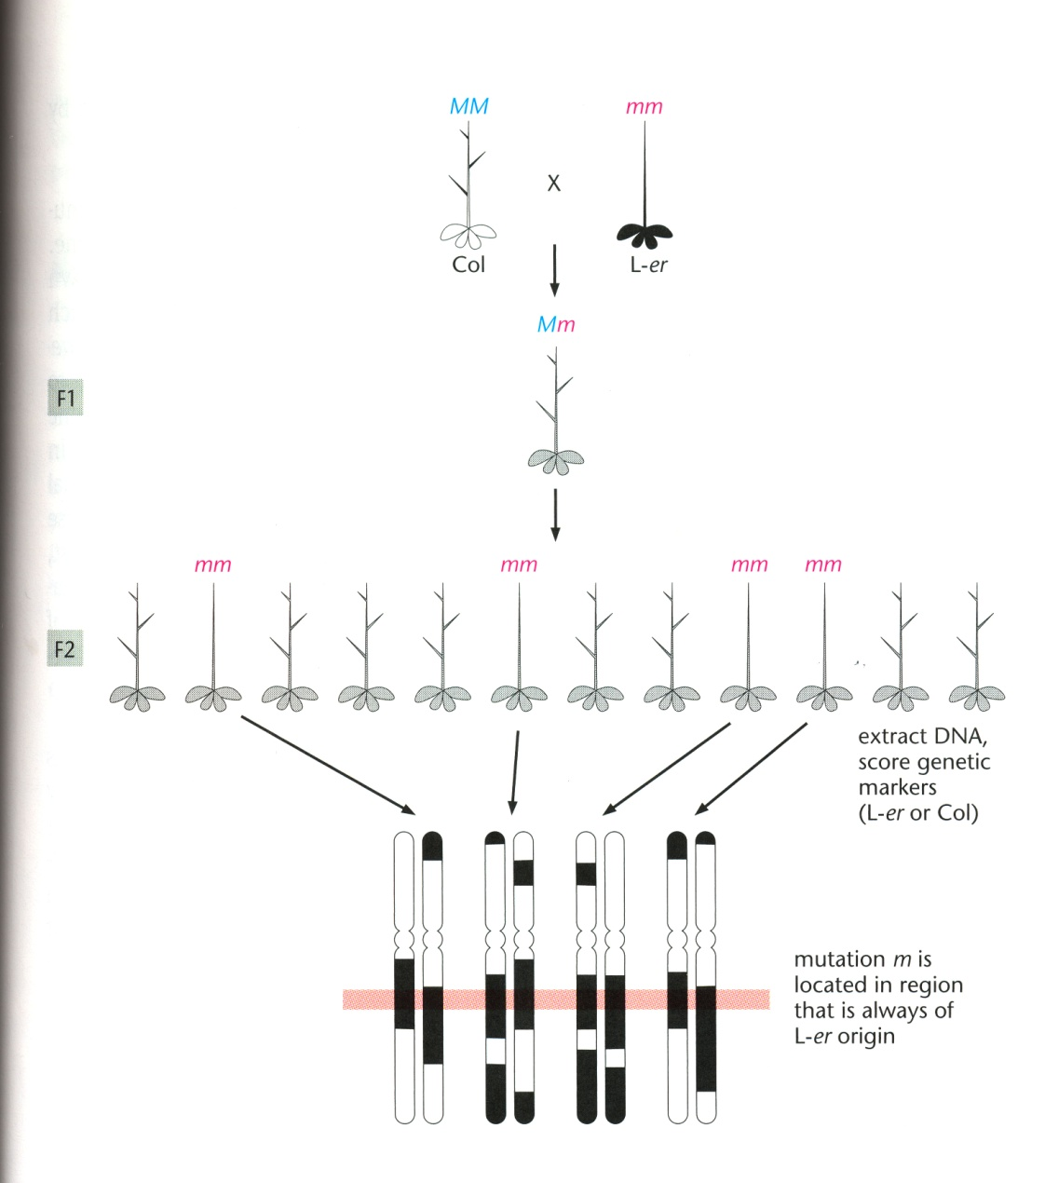
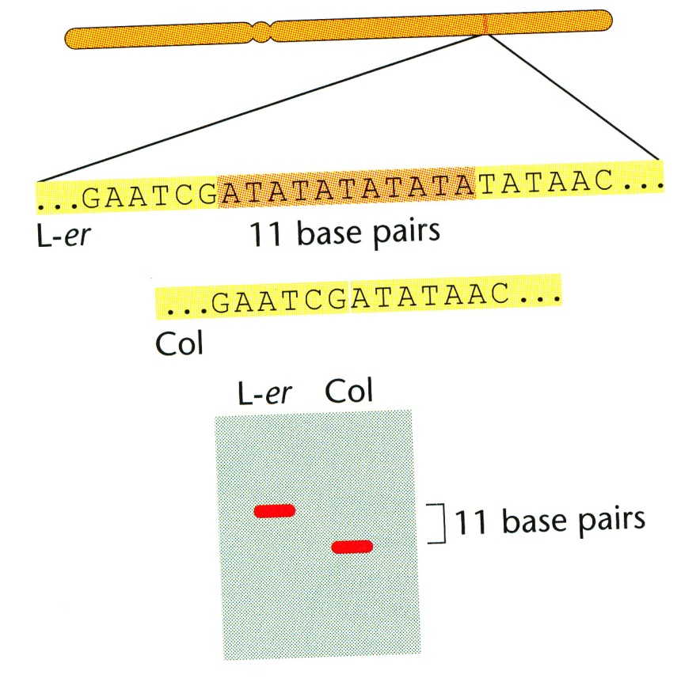
Map-Based Cloning of Mutated Genes

Slide 21
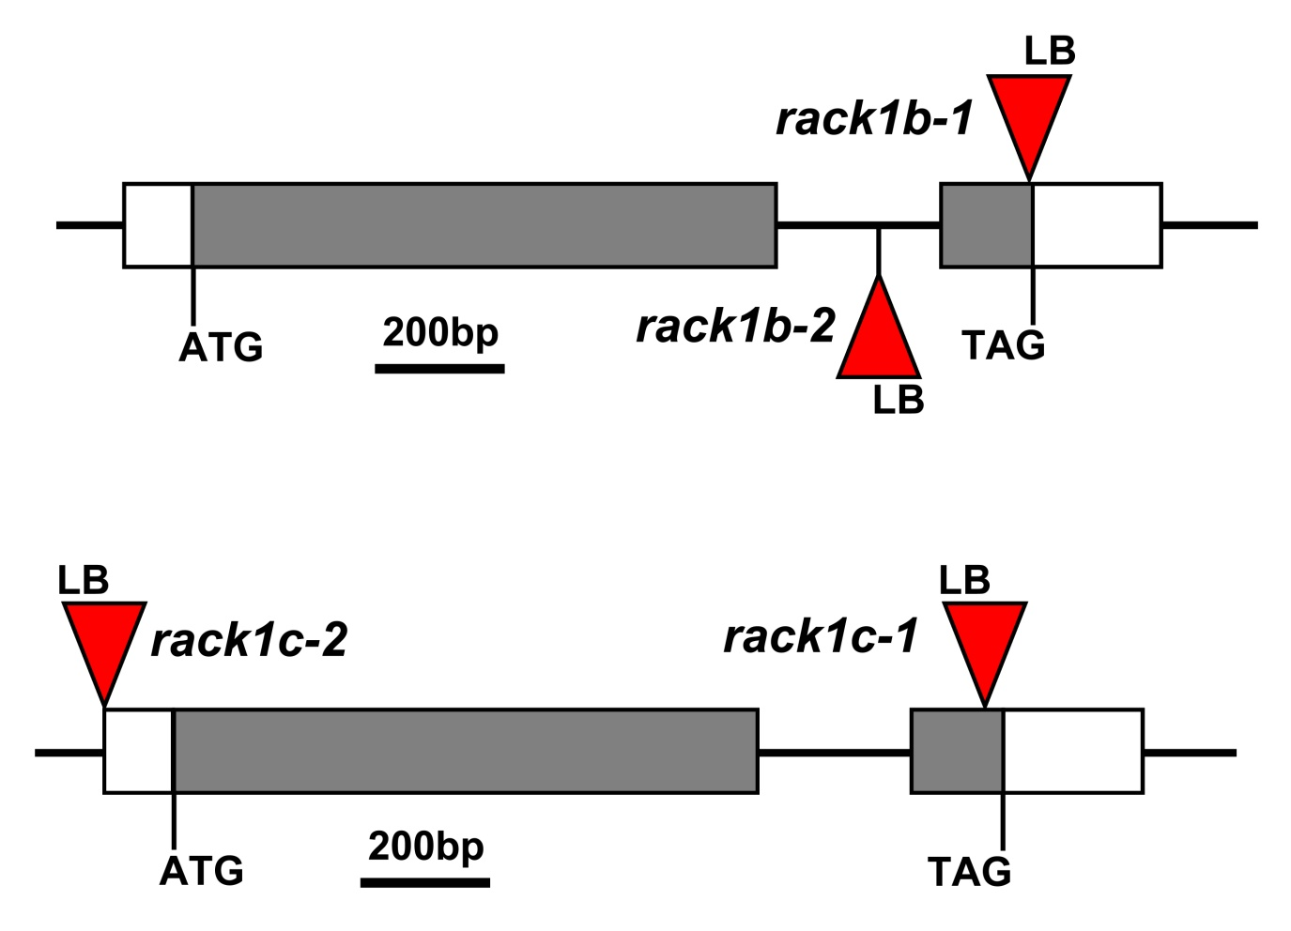
T-DNA Insertional Mutagenesis

Slide 22
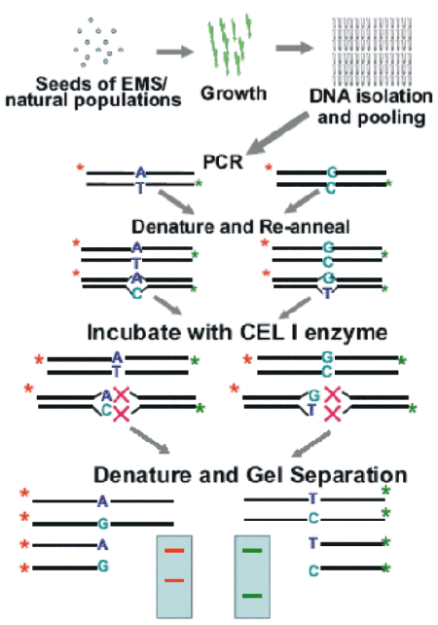
Tilling: Targeted Induced Local Lesions in Genomes

Slide 23
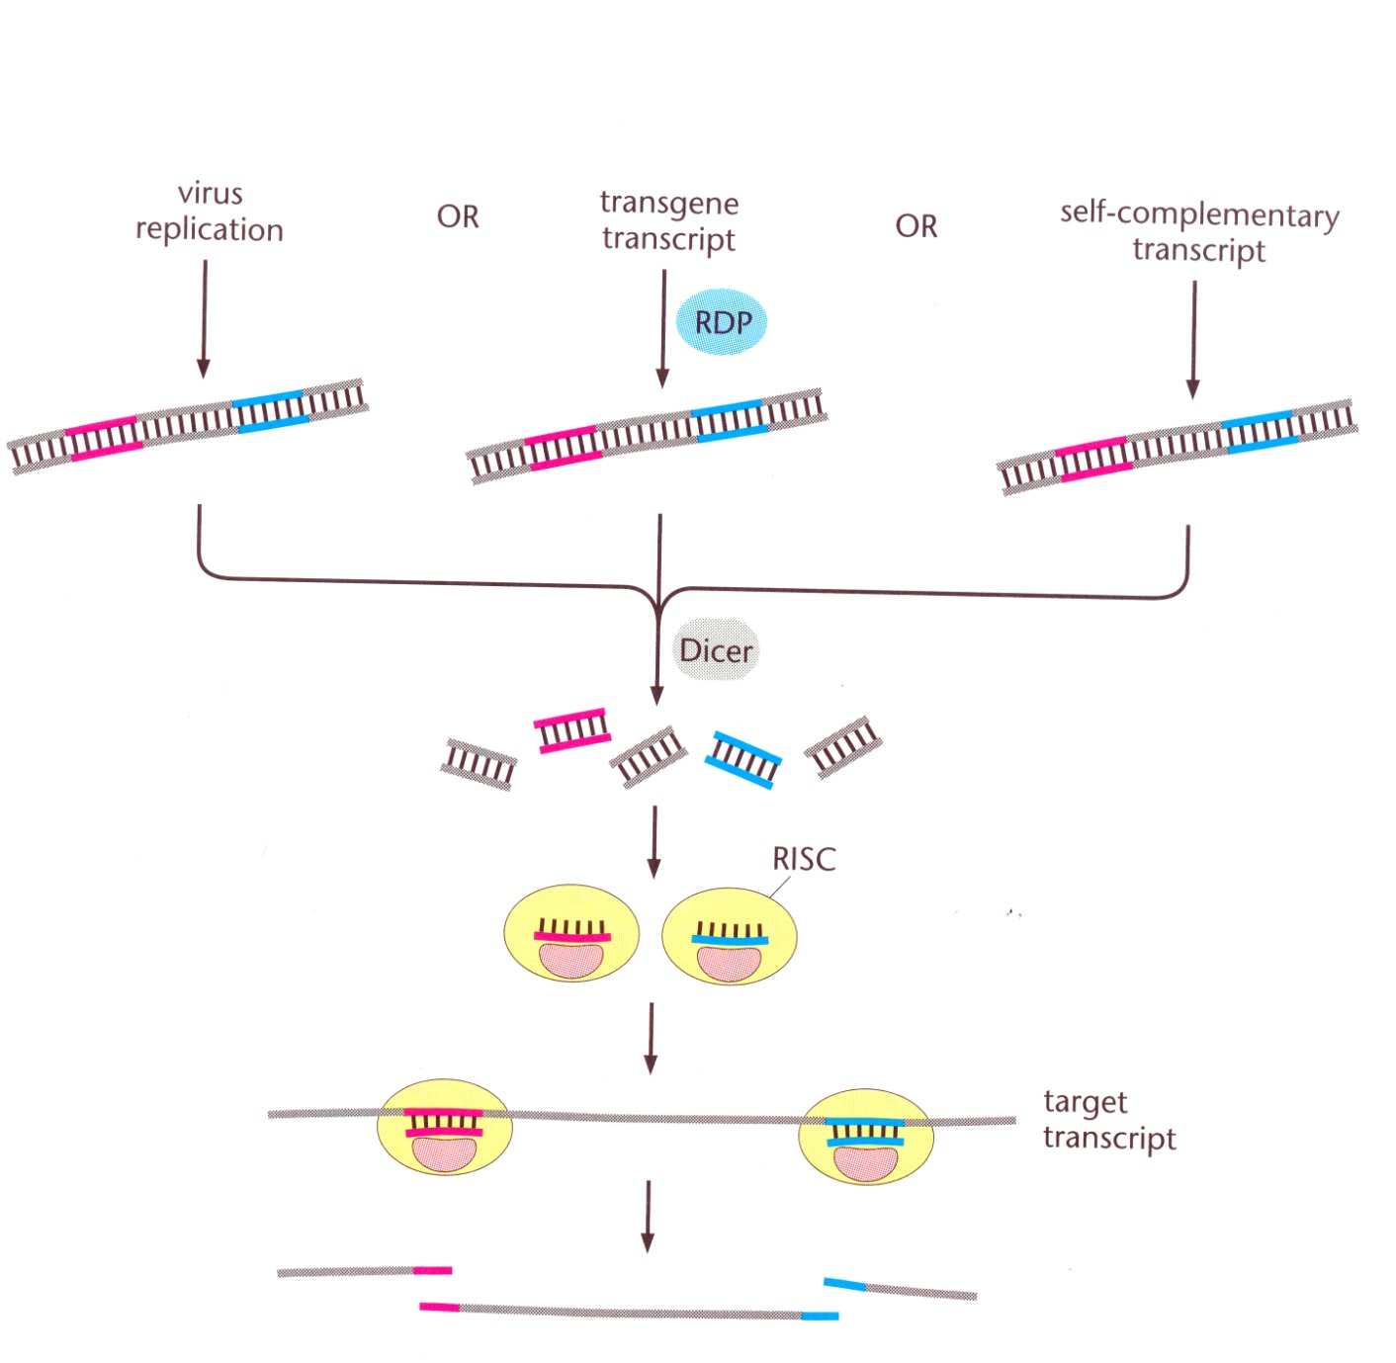
RNA Interference: Targeted Gene Expression Knockdown

Slide 24
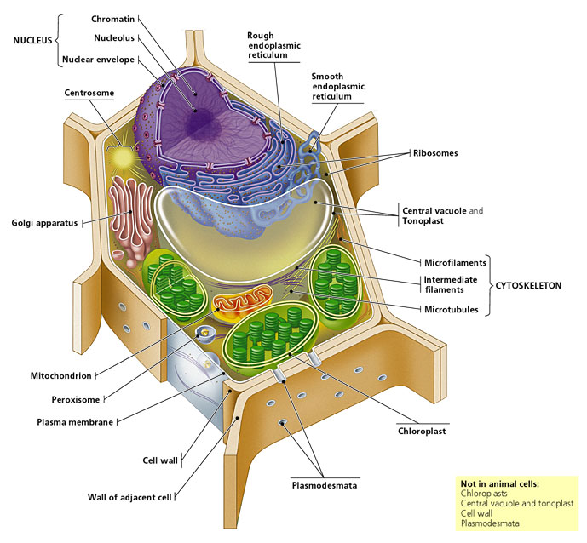
Plant Cell
Notes:
24

Slide 25
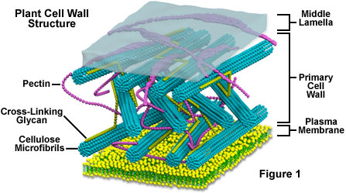
Cell wall
rigid wall surrounding the plasma membrane.
complex structure
protecting the cell and to regulating the life cycle of the plant organism.
Notes:
25

Slide 26
PLANTS IN MOTION
Movies at Indiana

Slide 27
Red arrow shows this molecules in the cell wall
Cellulose Microfibrils
Pectin
Middle Lamella
Cross-linking Glycan
Plasma Membrane

Slide 28
The result of RNA Interference is mostly manifested by
Elimination of all cellular RNA biosynthesis
Down regulation of all RNA mediated signaling pathway
No gene expression from a specific gene
Degradation of the DNA of a particular gene
Degradation of the mRNA and the protein of a specific gene

Slide 29
In the movie, successful cloning of a DNA fragment in a cloning site
is proved by
Inactivation of LacZ gene (Blue colony)
Inactivation of LacZ gene (White colony)
Activation of LacZ gene (Blue colony)
Activation of LacZ gene (White colony)

Slide 30
In the movie, the purple tomato is created with
Less amount of anthocyanin –a plant pigment
More amount of anthocyanin- a plant organell
More amount of b-carotene- a plant pigment
More amount of anthocyanin- a plant pigment

Slide 31
In the movie, Amish Farmers have adopted Bt corns. These GMO
corns resist corn disease caused by
European corn borer
Asian corn borer
European corn beetles
North American corn wasp

Slide 32
In the movie, Ugandan banana suffers from a disease causing
Low yield due to plants inability to move its resources within the plant
No yield due to complete shut down of the photosynthesis
Delayed fruit production due to infection by a pathogen
Low yield due to reduced capacity for photosynthesis

Slide 33
During PCR reaction, the main reason primers are needed is because
The primers will bind to DNA template and help amplify DNA
DNA polymerase needs double stranded template to amplify DNA
DNA polymerase can degrade the double stranded DNA at the primer site
The primers will facilitate the incorporation of dNTPs

Slide 34
All these organelles but this one are only found in a plant cell
Chloroplast
Cell wall
Vacuole
Plasmodesmata
Rough Endoplasmic reticulum

Slide 35
Tonoplast refers to
Cell wall outside of the plasma membrane
Plasma membrane outside the cytoplasm
Membrane surrounding the vacuole
Chloroplastic membrane
Mitochondrial membrane

Slide 36
During PCR primer synthesis, the template has the following
DNA sequence:
5’ ATGGCCCCTCAGTCCACCCCGACTTAGCTAG 3’
3’ TACCGGGGAGTCAGGTGGGGCTGAATCGATC 5’
Identify the correct 5 bp FORWARD primer
ATACG
GCTAG
TACCG
ATGGC

