Slide 1
Genetic Transformation of Plants:
Methods and Approaches to
Develop Transgenic plants

Slide 2
Steps in producing Transgenic
A source of foreign DNA containing the desired gene
A vector that carries the gene
Means to introduce the vector into host plant

Slide 3
Methods to create Transgenics
Agrobacterium mediated transformation
Electroporation
- Biolistic methods for direct entry
Protoplast fusion

Slide 4
Agrobacterium mediated Transgenic

Slide 5
Steps in T-DNA integration
Plant wound --> phenolics --> sense by VirA--> signal passed to VirG --> VirG activates
expression of other vir genes --> the
products of vir genes help to excise T-DNA from the Ti-plamsid

Slide 11
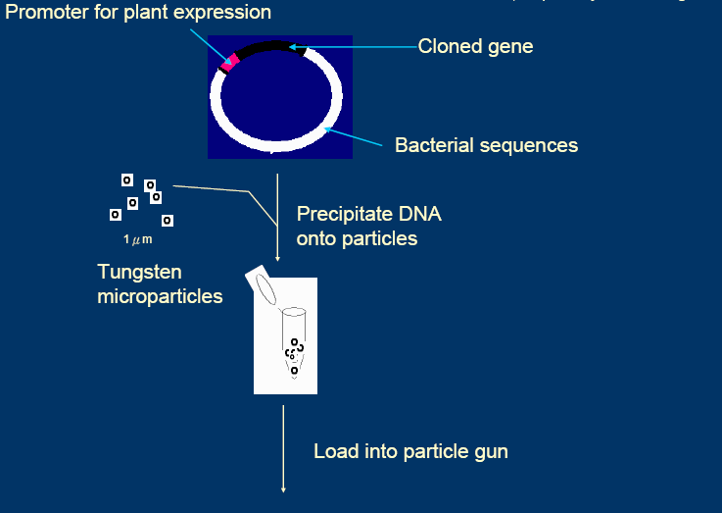

Slide 14
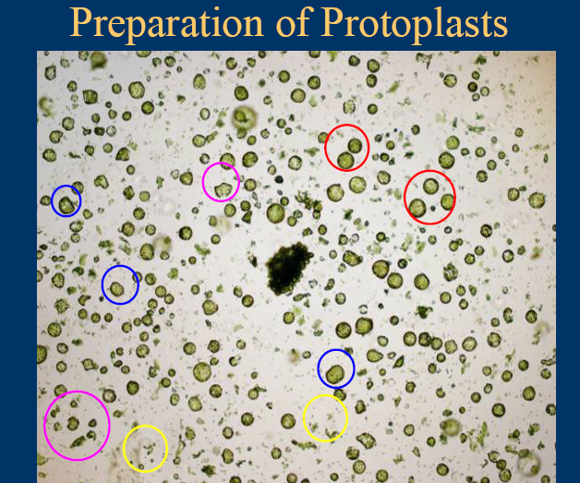

Slide 15
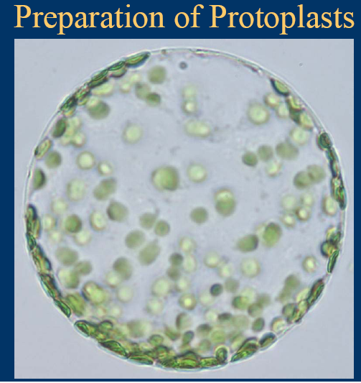

Slide 19
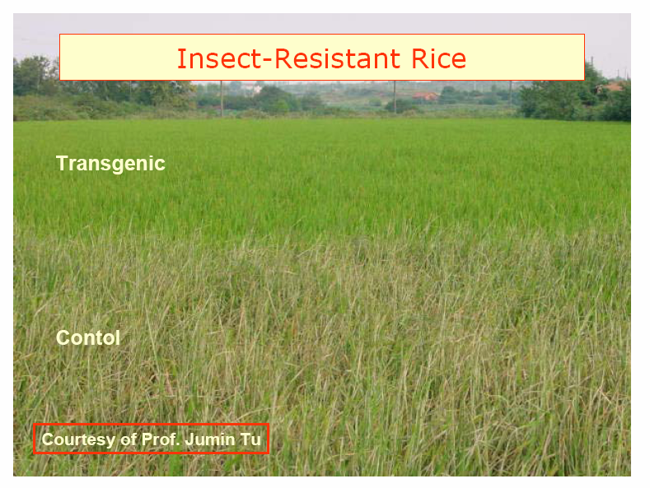

Slide 20
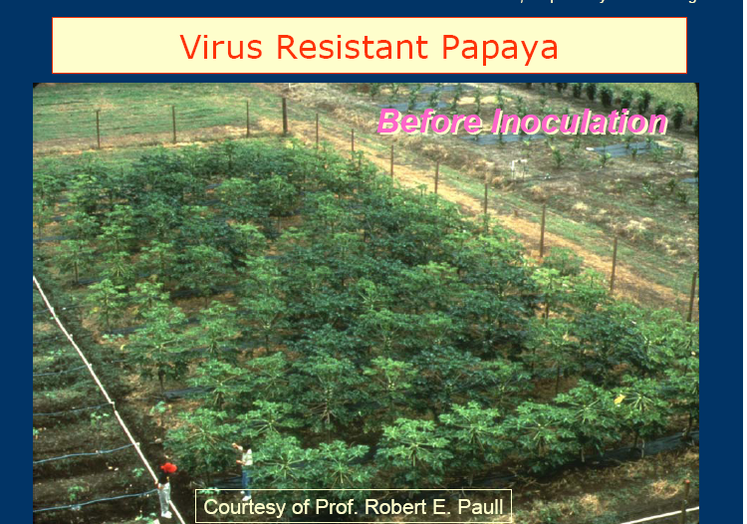

Slide 22
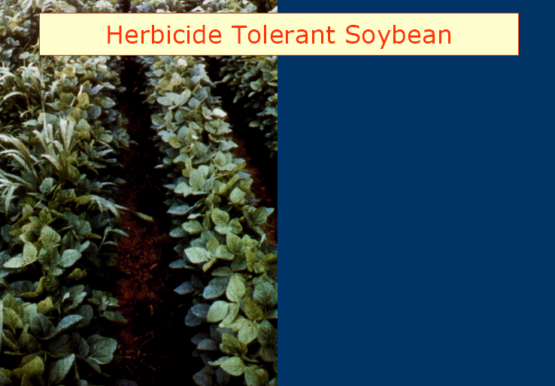

Slide 25
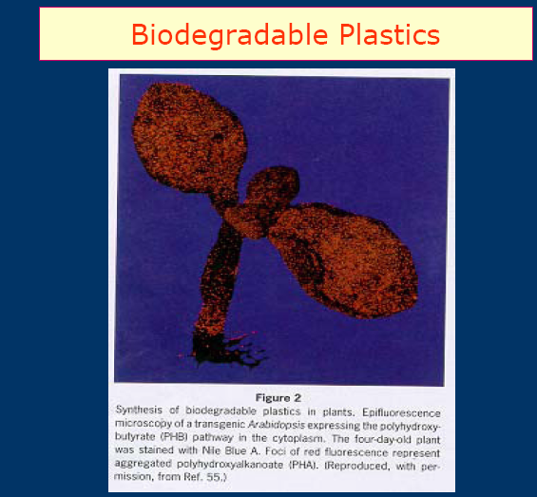

Slide 26
